Slide 1
More on science
Dr Giuseppe Maggiore

Slide 2
Research in Computer Science

Slide 3
Program structure
Constantly reinventing how to represent functionality intuitively, concisely, and flexibly
Procedural, functional, logic, declarative, object oriented
Static vs dynamic typing systems
Now a hybrid mixture of loosely typed languages, open source libraries, and decentralized multithreaded cloud architectures over multi-layer data representations
What are the central patterns underlying the optimality of these new architectures?

Slide 4
Virtualization
Local virtualization through time-sharing operating systems and virtual memory
Then virtual machine for software execution (e.g. Java VM, Microsoft CLR)
Virtual machine architecture that enabled cloud computing
How far can virtualization as an approach to abstraction go?

Slide 5
Statistical machine learning
Use of statistics against large data sets has taken over artificial intelligence
Strong industrial applications (Google, collaborative filtering, ad targeting, "big data")
This area of math has also taken over theoretical neuroscience, not to mention computer vision

Slide 6
AI
Computational building blocks necessary for cognition
Build on the success of machine learning to cover broader issues in intelligence
Conciliation between apparent logical nature of reasoning and statistical nature of learning

Slide 7
Representation of data at scale
Represent data when there is too much to fit in one database and millions of people are accessing it simultaneously?
Clever caching, layers of servers, NoSQL, sharding, etc.
What ties all these patterns together?

Slide 8
Computer security
Irresistible force of openness against immovable object of privacy
Encryption, security layers, permission models, system integrity techniques, etc. The future is both open and protected
How to achieve both?

Slide 9
Network models
Networks and the models that underlie them have become profoundly complex
Also include social networks, computing node networks, web-page link graphs, network data models, etc.
Network structures are unwieldy to analyse, but central to the future of computing

Slide 10
Hw/sw boundary
Since the Von Neumann architecture, this has been under continuous evolution in CS
Hardware is becoming more programmable and configurable (GPU computing, FPGAs), and hardware is adapting to software (hyper threading and virtualization features in CPUs)
Cloud computing is arguably a form of soft-configurable large-scale hardware infrastructure

Slide 11
Complexity and computability
Computational problems: NP-complete problems, what can be effectively computed, etc.
Most fundamental mathematical challenges of computer science
Nature of program analysis and optimization
They are related to foundational questions in quantum physics

Slide 12
Parallelism
Controlling, load-balancing and programming large parallel systems
Multicore devices on a chip or highly distributed systems
How to design algorithms for multi-core devices?

Slide 13
Evolutionary computation
Darwinian evolution to evolve complex mechanisms
Darwin's notions of variation and selection are computational notions
We seek understanding of the possibilities and limitations of the basic Darwinian process.

Slide 14
Simulation and virtual worlds
Lighting models
Physical models
Procedural generation
Etc.
https://www.youtube.com/watch?v=9H1gRQ6S7gg – 00:56

Slide 15
Can we discover everything?

Slide 16
Limits of logic
Gödel's incompleteness theorems
Inherent limitations of all but the most trivial axiomatic systems capable of doing arithmetic
Finding a complete and consistent set of axioms for all mathematics is impossible

Slide 17
Limits of logic
The first incompleteness theorem states that no consistent system of axioms whose theorems can be listed by an "effective procedure" (e.g., a computer program, but it could be any sort of algorithm) is capable of proving all truths about the relations of the natural numbers (arithmetic)

Slide 18
Limits of logic
For any such system, there will always be statements about the natural numbers that are true, but that are un-provable within the system

Slide 19
Limits of logic
Incompleteness theorem shows that the halting problem is un-decidable: there is no computer program that can correctly determine, given a program P as input, whether P eventually halts when run with a particular given input

Slide 20
Limits of logic
Computation and logic are fundamentally flawed
No, does not mean that religion works better ☺
Means that we know that they have precise limitations
Weird, huh?

Slide 21
Contemporary academic research

Slide 22

Academic authorship
Journals, articles, books, and other presentations
Main way to share, communicate, and discuss
New hypotheses
Theories
Experiments and results

Slide 23
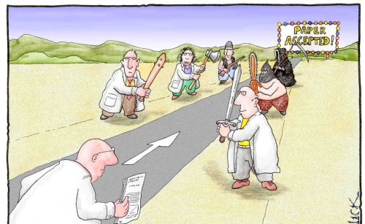
Peer review
Self-regulation process
Within a relevant field
Maintain standards
Improve performance
Provide credibility
Determine suitability for publication

Slide 24
Peer review
Also known as “refereeing”
Subjecting authors' scholarly work to other experts in the same field
Should be impartial
Is mostly anonymous
Has been fooled by dishonest authors

Slide 25

Peer review
A modern addition to the scientific method
To force sharing and collaboration
Spot mistakes or flaws in a complicated piece of work
Offer new perspectives
Anonymity
Rejects bad or irrelevant work

Slide 26
Scientific publication venues
All based on peer review
Blogs do not count because of no peer review
Scientific journals (ranking and acceptance rate)
Conferences (acceptance rate)
Workshops
Industrial journals (editorialized, still reviewed)

Slide 27
Failures of Peer Review

Slide 28
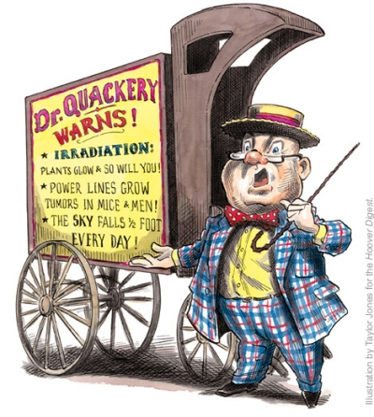
Peer review
Sometimes it fails
Mostly tests for acceptability, not correctness
Very innovative work may go unpublished
“Science advances one funeral at a time”

Slide 29
Fraud and plagiarism
1976, fewer than 10 fraud retractions for every one million studies published
2007, 96 per one million

Slide 30
Career pressure
Science is a very strongly career-driven discipline
Scientists depend on a good reputation to receive on-going support and funding
good reputation only upon publication of high-profile scientific papers
imperative to "publish or perish“
this may motivate desperate (or fame-hungry) scientists to fabricate results
Ease of fabrication

Slide 31
Difficulties in reproduction
Results are often difficult to reproduce accurately
Noise
Artefacts
Other extraneous data
Even without falsified data
Scientists can expect to get away with it
Or at least claim innocence
All investigations are made by experts in science but amateurs in dealing with criminals

Slide 32
Other forms of cheating
Fabrication: making up results and recording or reporting them
Falsification: not accurately representing results
Plagiarism: appropriation of others’ work
Ghost-writing: contribution by someone other than the authors (contributions from drug companies)
Plagiarism + financial fraud ☺
Conferring authorship on those that have not made substantial contributions

Slide 33
Fraudolent journals
Pay per publish
Can be cited; few people control the validity of cited sources from an International Journal...

Slide 34
Fraudolent journals
What do porn star Ron Jeremy, Max Weber and Michael Jackson have in common? Very little — except the three names appear in the list of references for a recent hoax paper by a group of Serbian academics who scammed a Romanian journal.
Reference to the scholarship of Jackson, Weber, Jeremy
Citations to new studies by Bernoulli and Laplace
References to the “Journal of Modern Illogical Studies”
Reference to a researcher named, dubiously, “A.S. Hole.” and to the noted Kazakh polymath B. Sagdiyev, otherwise known as Borat.

Slide 35
Fraudolent journals
How do we increase the impact factor (estimate of quality) of Brazilian journals?
Improve quality of papers
OR, add hundreds of cross-references between articles in these journals!

Slide 36
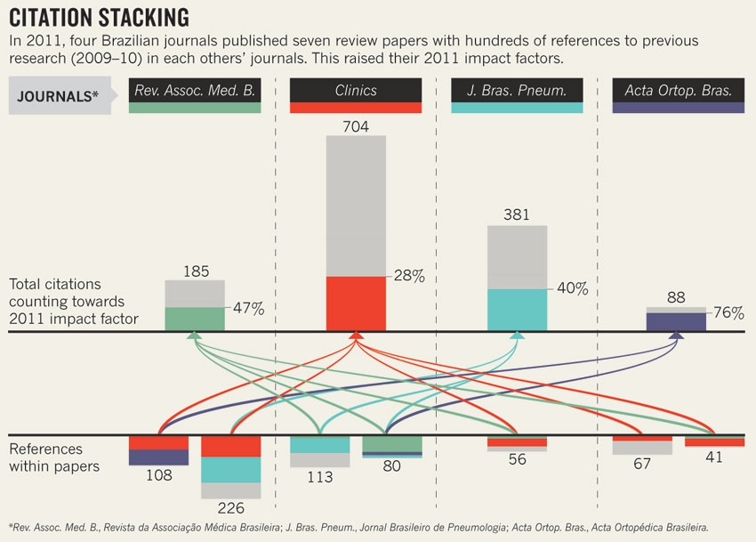
Fraudolent journals

Slide 37
THE Global brain

Slide 38
Is it all so bad?
Not really, aberrations are statistically limited
Most scientists really advance knowledge with honesty and humility
Collective of scientists and publication even resembles shared global consciousness
Publications are more important for honest sharing than for accuracy and absolute truth

Slide 39
Collective consciece
Collective conscience: the set of shared beliefs, ideas and moral attitudes which operate as a unifying force within society

Slide 40
Global brain
People + ICT = intelligent, self-organizing system
As the internet becomes faster, more intelligent, and more encompassing, it increasingly ties us together into a single information processing system
Like a nervous system for the Earth

Slide 41
Global brain
Intelligence is collective or distributed
Not centralized or localized in any particular individual, organization or computer system
Emerges from the dynamic networks of interactions between its components, a property typical of complex adaptive systems

Slide 42
Global brain and research
Papers (playing a role similar to neurons) connected by citations (playing a role similar to synapses), together forming an associative network along which information propagates
Information propagates from scholar to scholar
Similar to the spreading activation that neural networks in the brain use to process information

Slide 43
Global brain and research
It is an exciting time to be alive ☺

Slide 44
Thank you!
This concludes the course. Hopefully you learned a bit and it was of some help and interest.

Slide 45


